Slide 1

Project – 1:
Airbnb Rental Market Analysis
2017-2020
04/18/2020
Fabienne Zumbühl | Lizeth Orozco | Jairo Humberto Leon Cardoso | Stefan Blagojevic

Slide 2
Agenda
1
Project Overview
2
Data Acquisition & Processing
3
Data Analysis
4
Discussion of Findings

Slide 3
Executive Summary
Research Question
Research Scope
Hypothesis
What?
Do hosts that change their status to
Superhosts charge more per night?
Why?
Superhosts have greater duties
and could charge more
H₁ = Hosts increase their price when
becoming a Superhost
H₀ = Hosts don’t increase their price
when becoming a Superhost
On Location:
New York City
On Time:
March 2017 – March 2020
Main Finding
Finding
Finding
Converting from Host to Superhost,
the price does not increase
H₁ = Hosts increase their price when
becoming a Superhost
Hosts of 943 listings changed
their status from host to Superhost
between 2017 and 2020
The median Superhost
charges the most in Manhattan
and Brooklyn

Slide 4

1. Project Overview

Slide 5
1. Project Overview
What was our Motivation?
What were our main Questions?
From 2017 to 2020, did Airbnb Superhosts charge more per night than a regular Airbnb hosts in the NYC ?
Which borough in NYC would be ideal to own an Airbnb rental?
What is the price discrepancy per night between hosts & Superhosts?
Interest because of exposure to Airbnb
Interest in the Superhost status
New York is the biggest market for Airbnb
Notes:
What is the price discrepancy per night between hosts & superhosts?
Which borough is the most affordable & why?
Price by object type

Slide 6
1. Project Overview
Hypothesis
H₁ = Hosts increase their price per night when becoming a Superhost
H₀ = Hosts don’t increase their price per night when becoming a Superhost

Slide 7

2. Data Acquisition & Processing

Slide 8



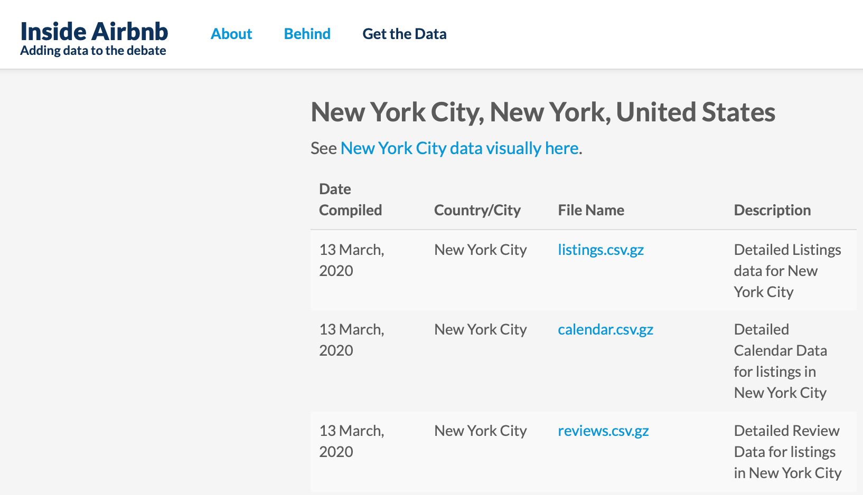
2. Data Acquisition & Processing
Down/Uploading Files in the Time of the Coronavirus … Duboce Triangle and AT&T, A Slow Story
Retrieval of 37 Zipped File Months from Inside Airbnb
Inside Airbnb
(http://insideairbnb.com/get-the-data.html)

Slide 9
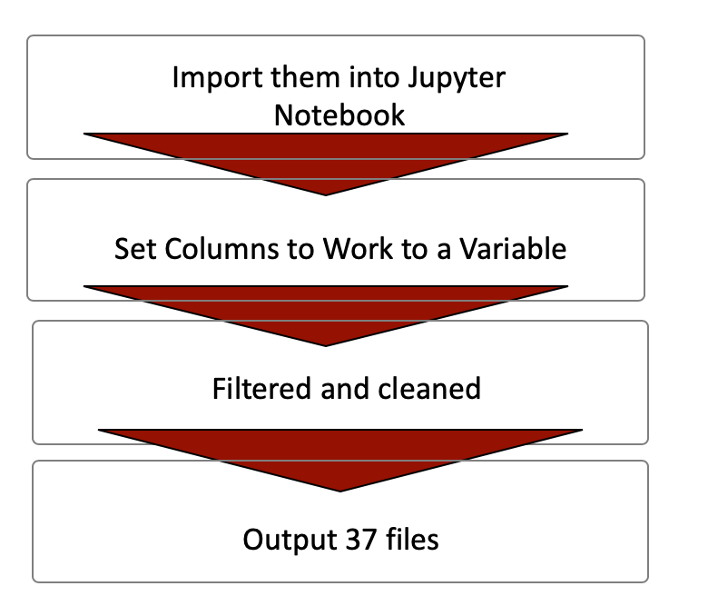
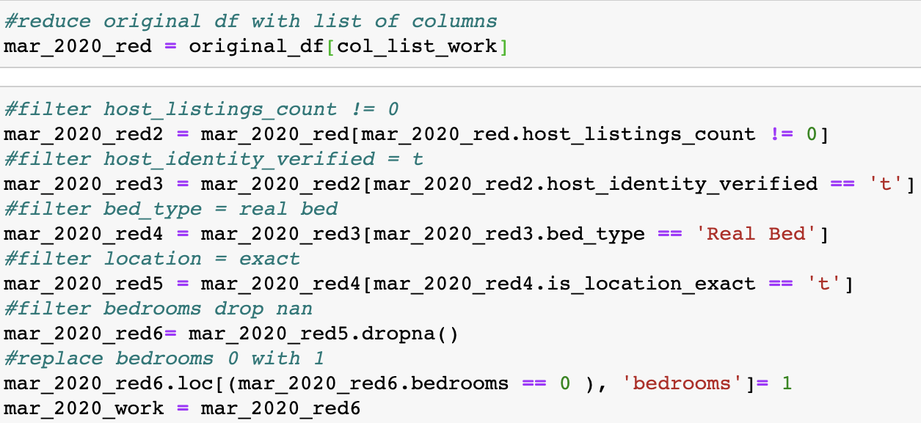
2. Data Acquisition & Processing
Downsizing to ‘../Uploadable Files.csv’
Super Duper Work Flow!

Slide 10
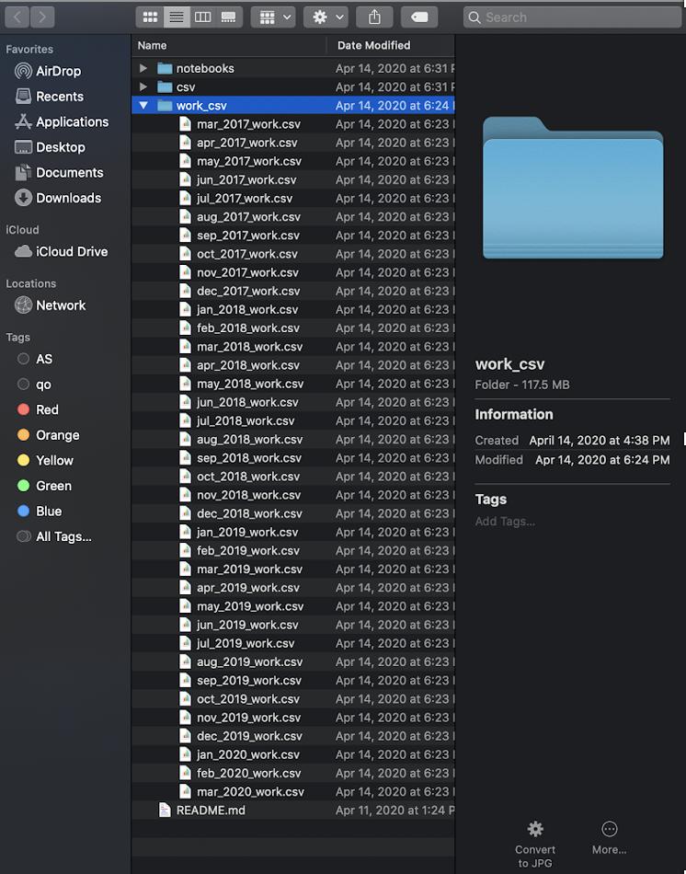
2. Data Acquisition & Processing
Booya!!! All Up There in the GitHub Universe!
A Present
to My Group Mates
for Their ENTERTAINMENT!
I am done with typing! Siri, Activate Voice Recognition!!

Slide 11

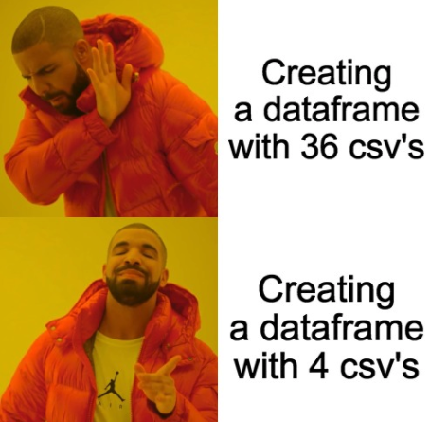
2. Data Acquisition & Processing
Narrowing down the Scope
Strategy changed due to time constraints and reduced from monthly to yearly trending.
Use data for same month for the past 4 years.
The narrowing down removes the variable of seasonal changes in prices

Slide 12
2. Data Acquisition & Processing
Data Needed
Data on object types
Data from 2017 – 2020
Data on superhosts in NYC
Data on prices per night per borough
Data on the change of price host vs. superhost
Data Source
Inside Airbnb
(http://insideairbnb.com/get-the-data.html)
Notes:
Airbnb Superhost Criteria:
Completed at least 10 trips OR completed 3 reservations that total at least 100 nights
Maintained a 90% response rate or higher
Maintained a 1% percent cancellation rate (1 cancellation per 100 reservations) or lower, with exceptions made for those that fall under our Extenuating Circumstances policy
Maintained a 4.8 overall rating (this rating looks at the past 365 days of reviews, based on the date the guest left a review, not the date the guest checked out)
Airbnb Superhost criteria is already set, we don’t need to look at the “review.csv” from the website.

Slide 13

3. Data Analysis

Slide 14
3. Data Analysis
Identifying Inflection Points – The change from Host to Superhost
How do we identify at which point a host became a Superhost?
Using the Dataframe combining 4 years of listings, choose 2 starting points
How many listings in NYC were not Superhosts in March of 2017 AND…
How many of those listings became Superhosts in March 2020?

Slide 15
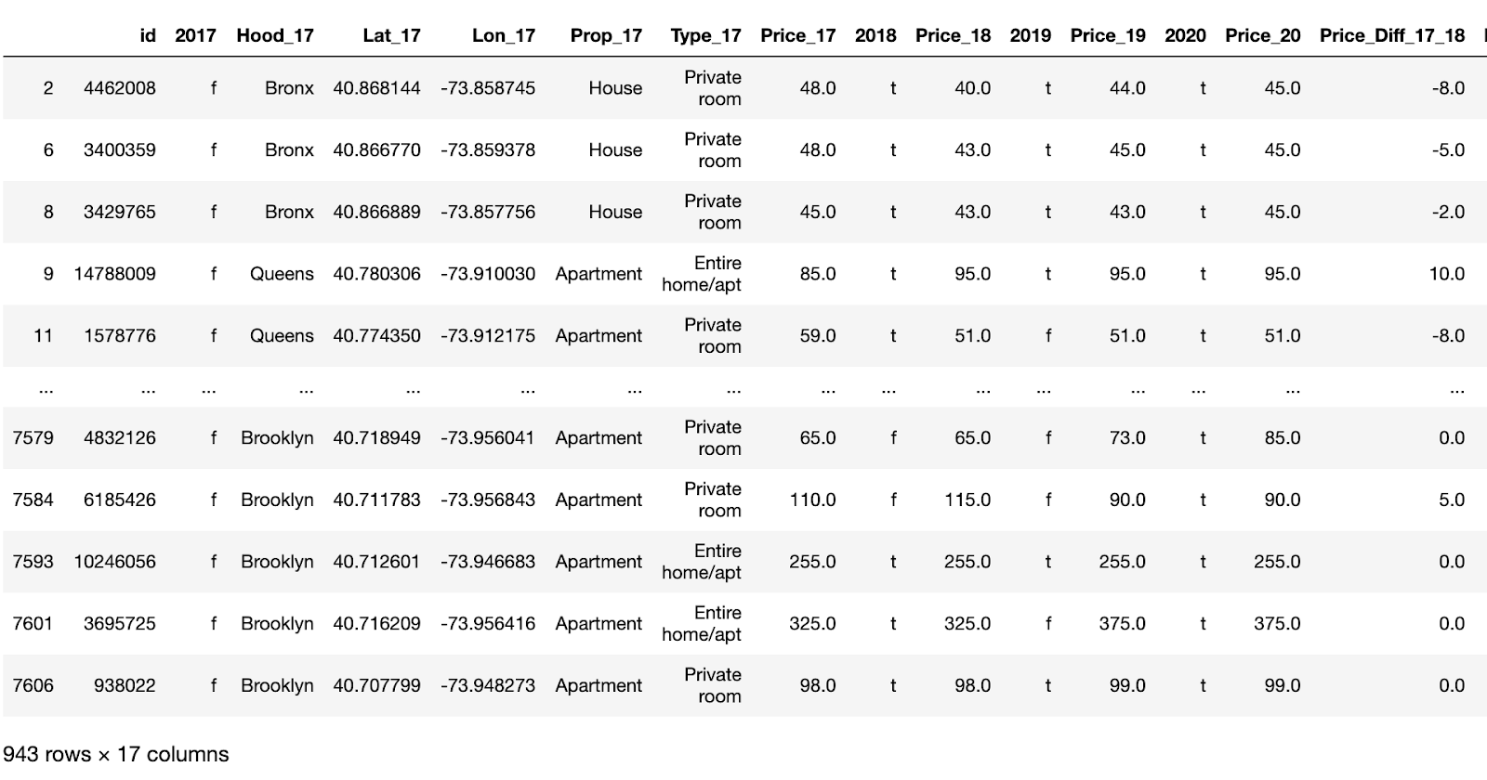
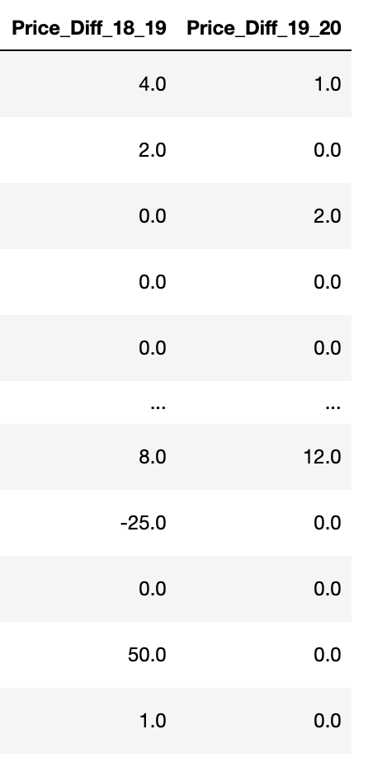
3. Data Analysis
Our starting Dataframe for our data analysis
We start to see the status and price changes over the years. Progress!!!
The hosts of 943 listings have upgraded their status from a regular host to a Superhost from 2017-2020

Slide 16
3. Data Analysis
Change of Host to Superhost Listings throughout the four years
 | 2017 | 2018 % total ‘18 | 2019 % total ’19 | 2020
Superhosts | 0 | 468 48.7% | 596 63.2% | 943
Hosts | 943 | 475 49.4% | 347 36.8% | 0
Hosts of 468 listings moved up as
Superhosts
Hosts of 380 listings stayed Superhost
Superhosts of 88 listings resigned as Superhosts
Hosts of 216 listings moved up as Superhosts
Hosts of 347 listings moved up as
Superhosts

Slide 17
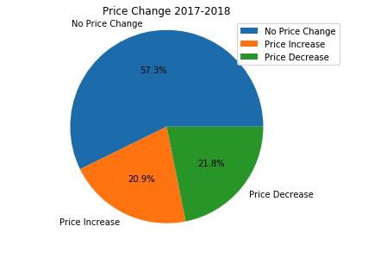
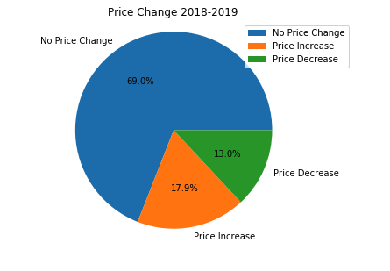
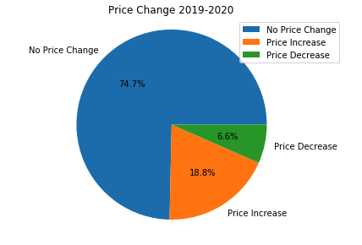
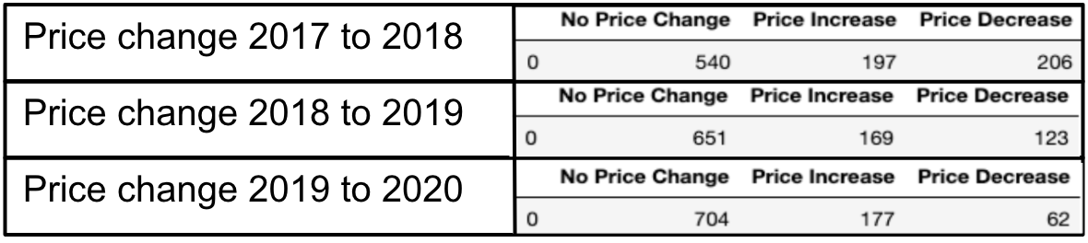
3. Data Analysis
General Price Changes in the Market

Slide 18
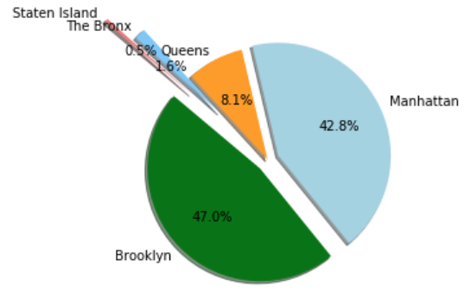

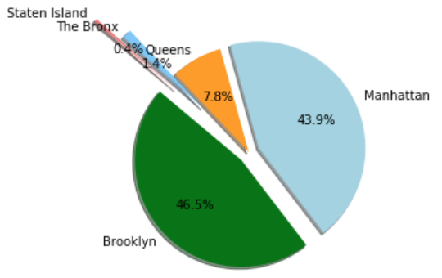
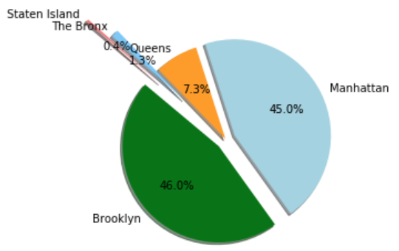
3. Data Analysis
Market Share of Listings by Borough (2017-2020)
Host to Superhost
March 2017
March 2018
March 2019
March 2020

Slide 19
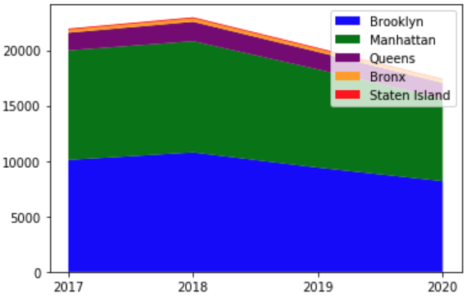
3. Data Analysis
Listings by Borough (2017-2020)
Notes:
What kind of Listings?

Slide 20
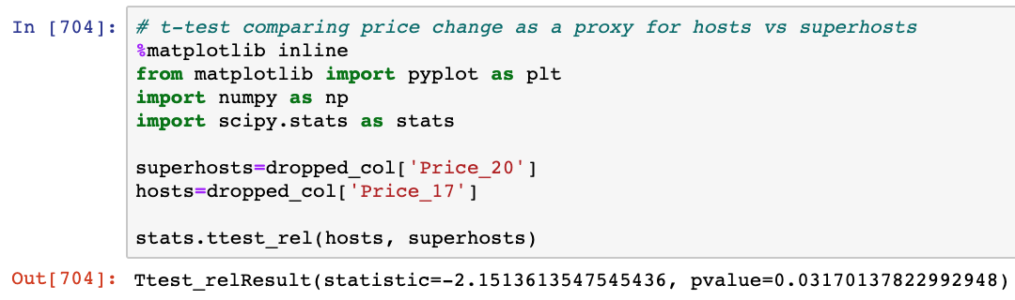
3. Data Analysis
Paired sample t-test
H₀ = Hosts don’t increase their listing price per night when becoming a superhost
H₁ = Hosts do increase their listing price per night when becoming a superhost

Slide 21
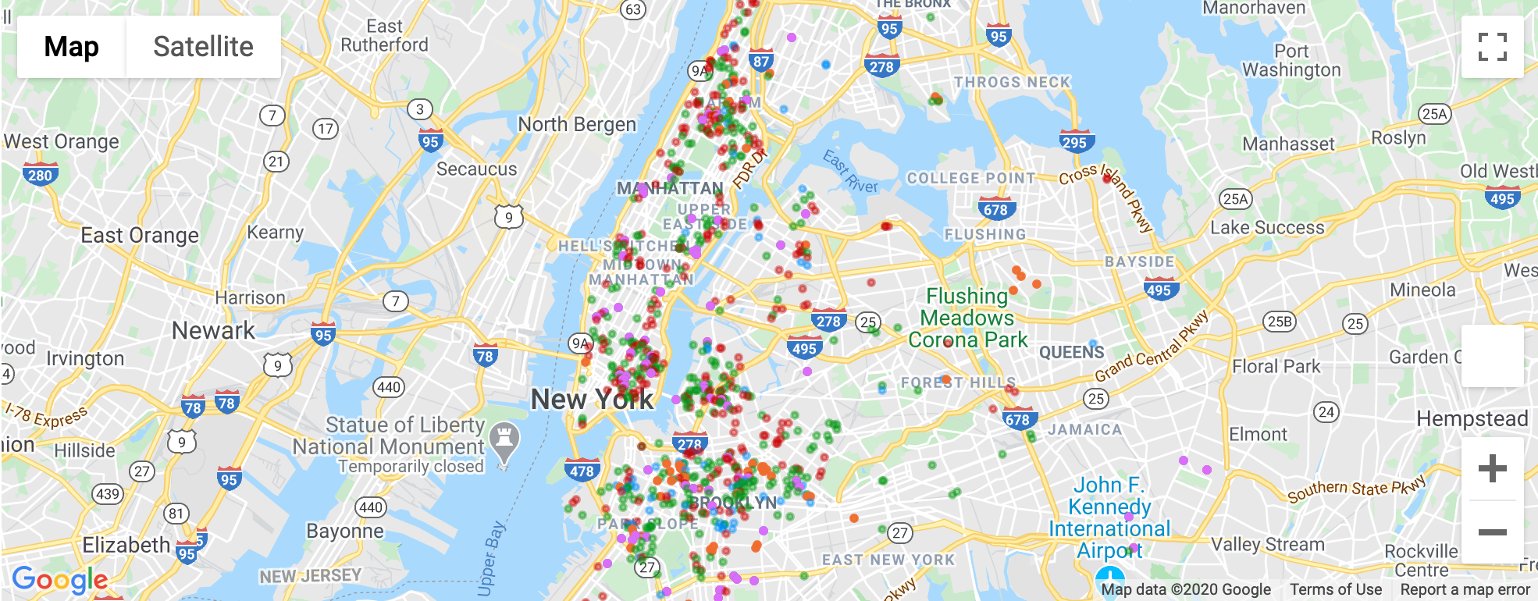
3. Data Analysis
Where exactly do the newly upgraded Superhosts live?
Consolidated View (2017-2020)
Entire Apartment
Apartment with Private Room
Entire House
House with Private Room
Drop-outs 2018/2019 and new Superhosts 2019/2020
Guesthouses
East Village
Lower East Side
Harlem
Brooklyn

Slide 22
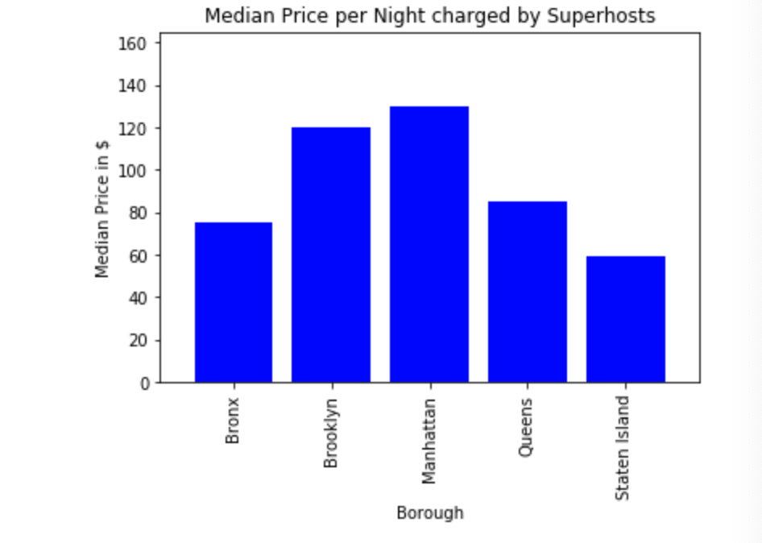
3. Data Analysis
The median Superhost charges the most in Manhattan and Brooklyn

Slide 23
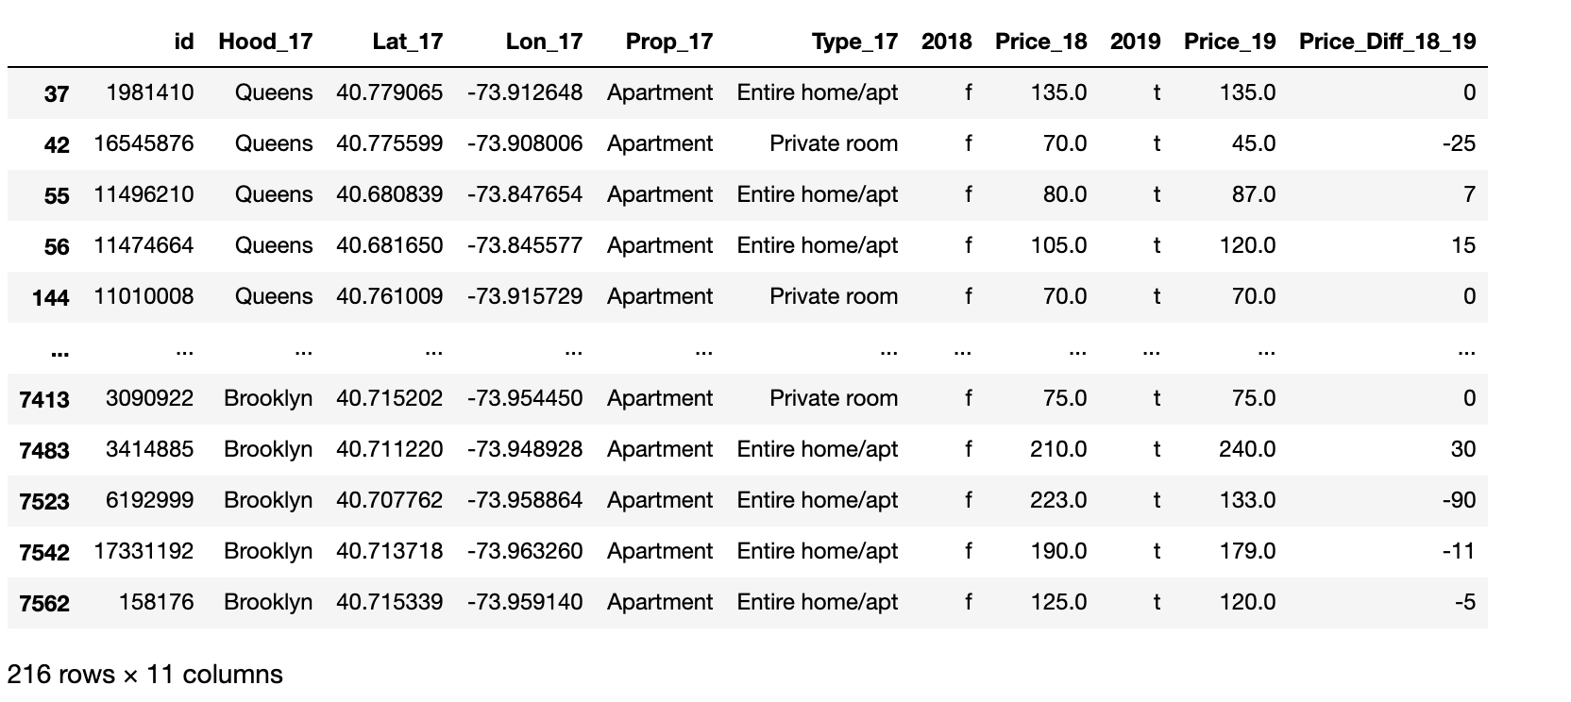
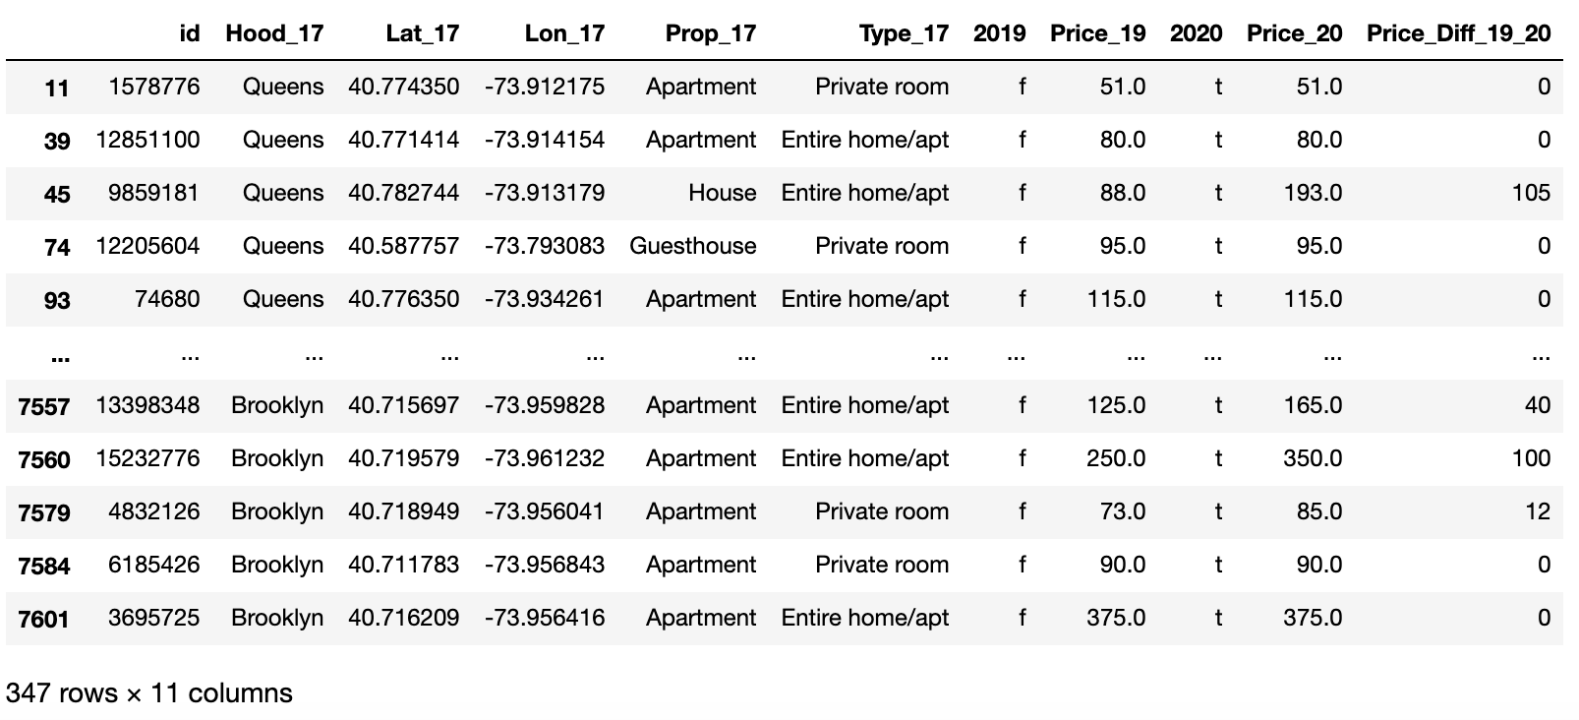
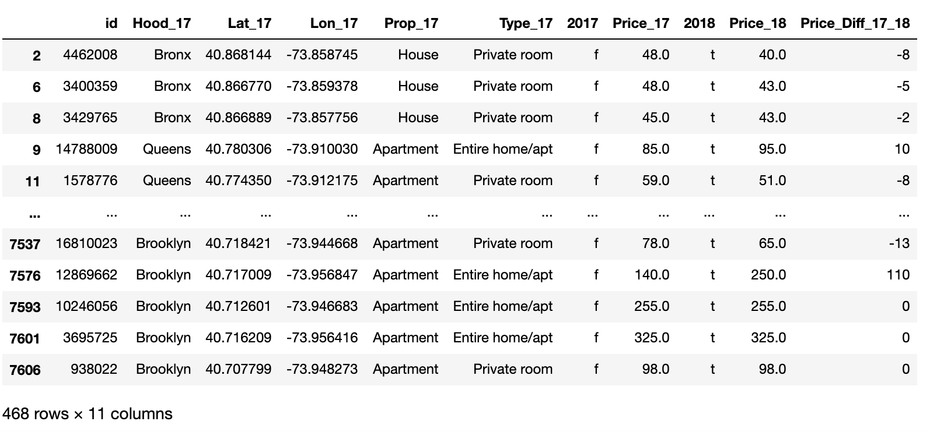
3. Data Analysis
Let’s get back to our main question: Do the Superhosts charge more when attaining their status?
468 new Superhosts in 2018
216 new Superhosts in 2019
347 new Superhosts in 2020
Notes:
We grouped them by borough and took the median of the Price Difference per Listing

Slide 24
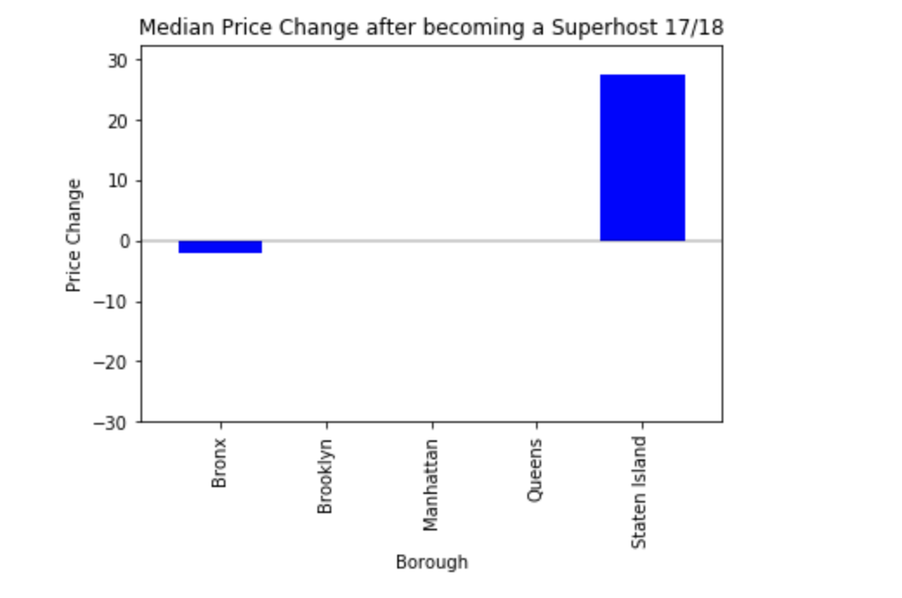
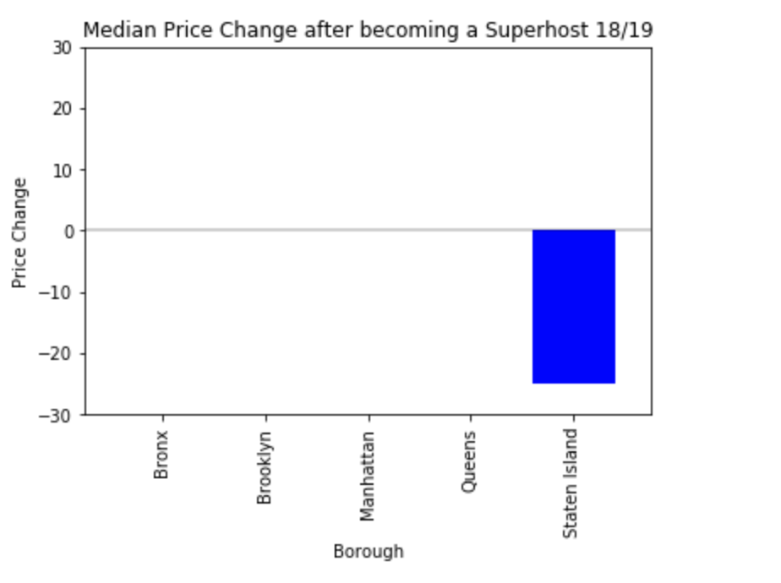
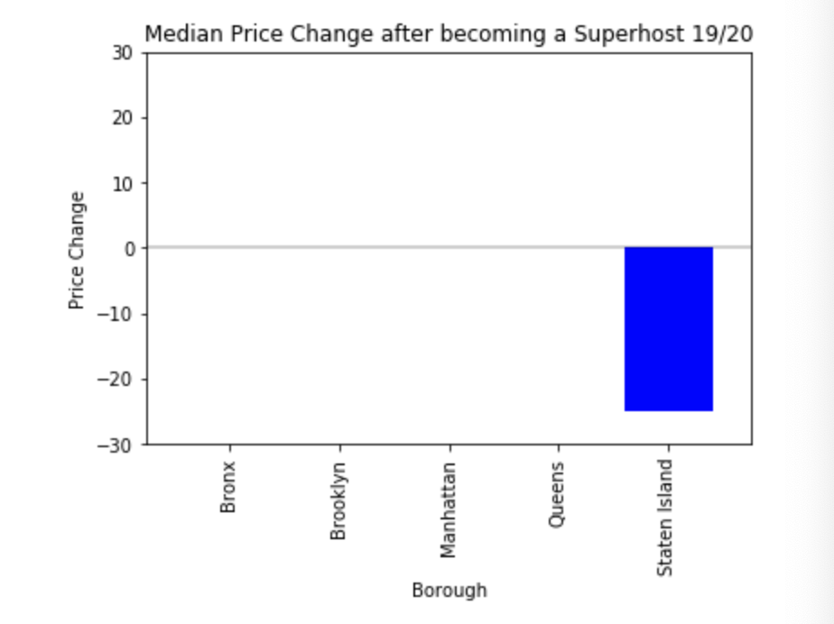
3. Data Analysis
The Median Price change per Borough is (almost) zero! (exception Staten Island)

Slide 25
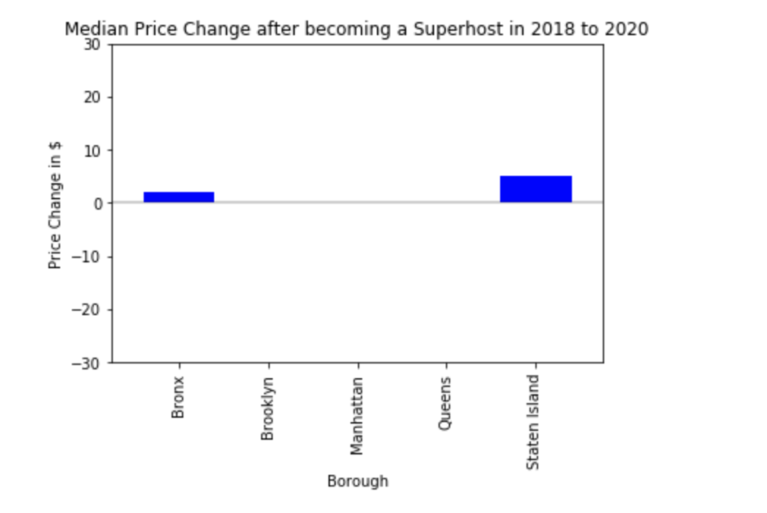
3. Data Analysis
The same hold True for people who have been Superhosts from 3 consecutive years

Slide 26

4. Discussion of Findings

Slide 27
4. Discussion of Findings
Based on our research approach, our finding is that the Median Superhost Rental is not increasing it’s price from year n (regular Host) to n+1 (Superhost).
Based on the findings, the incentives of becoming a Superhost is charging more money per customer, but being on top of the search list, thus attracting more customers and make more money like that (Assumption)
The competitiveness in the NYC rental market is so high that Superhost might loose customers by increasing their prices due to price inelasticity of the demand (Assumption)
Limitations of Findings:
Dataset was limited to 943 listings
Findings are not universally applicable for the NYC market, but only for the years studied
Findings are thus also not universally applicable for the whole Airbnb market

Slide 28
4. Discussion of Findings
We can reject our Hypothesis
H₁ = Hosts increase their price per night when becoming a Superhost
H₀ = Hosts don’t increase their price per night when becoming a Superhost

Slide 29
4. Discussion of Findings
Lessons Learned
Don’t plan on doing things with the data without having the data
Acquiring and cleaning up the data is 50% of the job
It is hard to decide which visualization to choose from (out of the 20 charts created)
A research questions has a lot of facets and it is important to disassemble the research question
It’s easy to loose track on the research question we wanted to answer

Slide 30
Thank you!!!
Questions?

